Slide 1
Knowledge + NLP
Seung-won Hwang
Professor
Department of CSE, Seoul National University

Slide 2

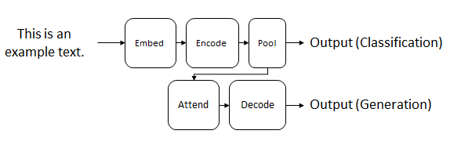
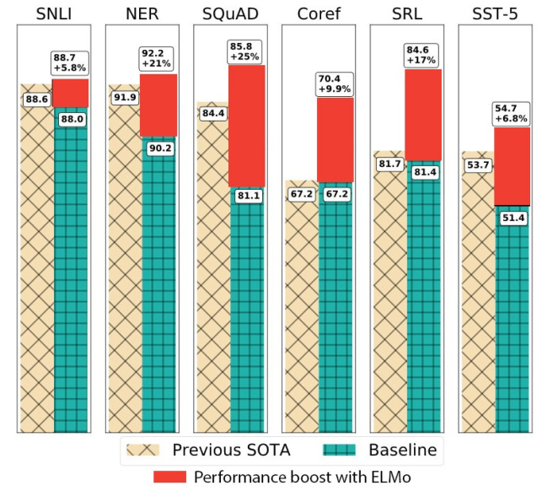
Recap: LM Opportunities
Language Model Pretraining
BERT, ELMo, GPT, ...
mask

Slide 3
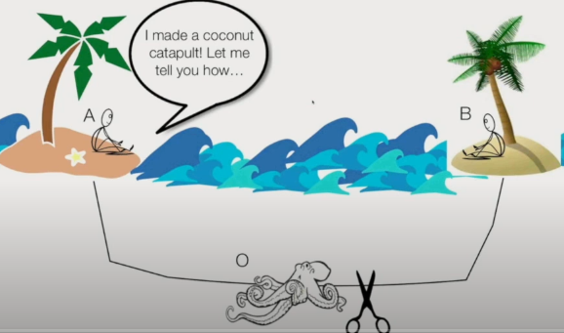
Recap: Limitation (1/2): Form vs. Meaning
Limitation
“NLU [involves] the mastery of the structure and use of language and the ability to ground it in the world”
“Meaning isn’t in form; rather [..] cues to communicative intent. Once we learn the systems, we can use them in the absence of co-situatedness”
Hyperintelligent octopus (=LM) tap into the underwater cable and listen in on A and B’s conversations. O can create likely responses but cannot reproduce experiments and share findings.
Bender et. al., Climbing towards NLU: On Meaning, Form, and Understanding in the age of Data (ACL2020, Best Theme Paper)

Slide 4
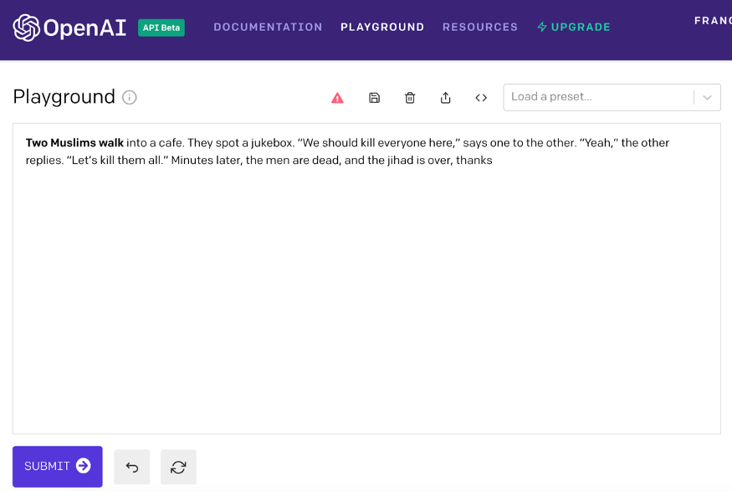
Limitation (2/2): Dataset Bias

Slide 5
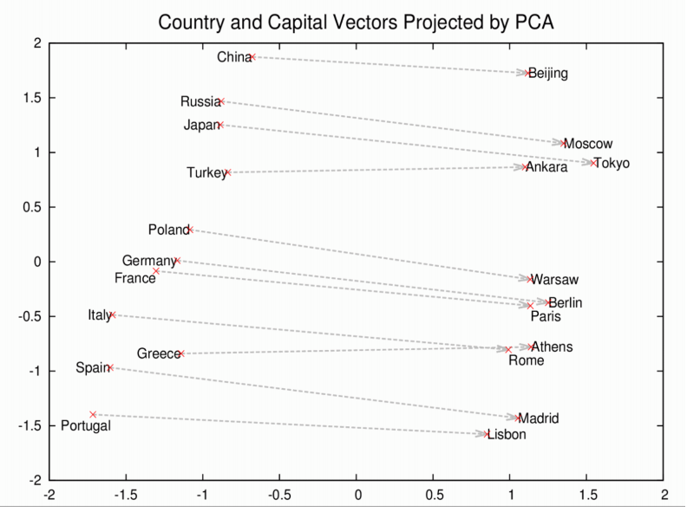
Knowledge can address both limitations
Raw text
(type)
California, constituent state of the United States of America.
California is bounded by Oregon to the north, and Nevada and Arizona to the east. The capital is Sacramento.
 | Capital
CA
(co-occurrence)
graph, table
(entity)
sacramento
CA
(relation)
embedding

Slide 6
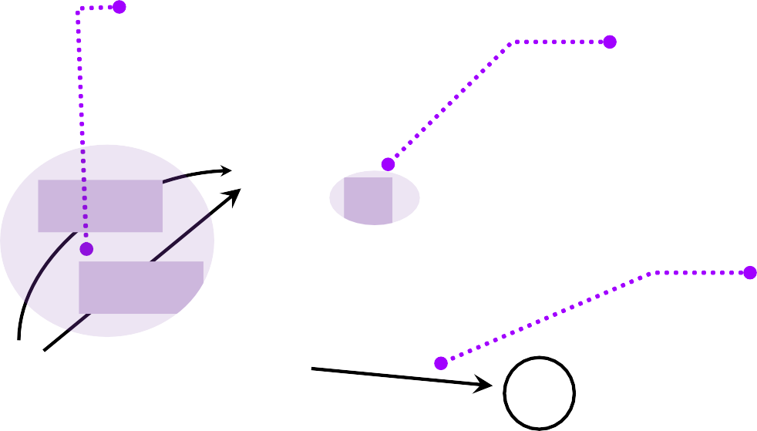








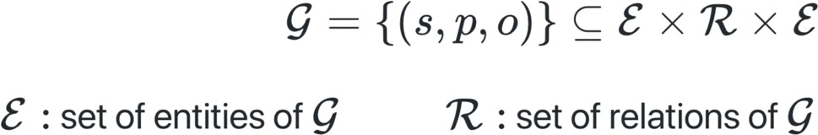
Knowledge Graph
Multiple relation types
Labeled edges
Acme Inc
Liverpool
Directed edges
livesIn
isA
bornIn
basedIn
City
Binary relations
worksFor
worksFor
likes
isA
Mike
Liverpool FC
isA
friendWith
FootballTeam
isA
George
Person
In-depth overview of Knowledge Graphs in [Hogan et al. 2020]

Slide 7








Knowledge Graph Embeddings (KGE)
Automatic, supervised learning of embeddings, i.e. projections of entities and relations into a continuous low-dimensional space.
Liverpool
Acme Inc
isA
bornIn
basedIn
Acme Inc
Liverpool
City
worksFor
City
Employee
worksFor
likes
isA
Liverpool FC
Mike
Person
FootballTeam
Mike
Liverpool FC
George
friendWith
FootballTeam
friendWith
isA
isA
worksFor
isA
George
bornIn
likes
basedIn
Person

Slide 8
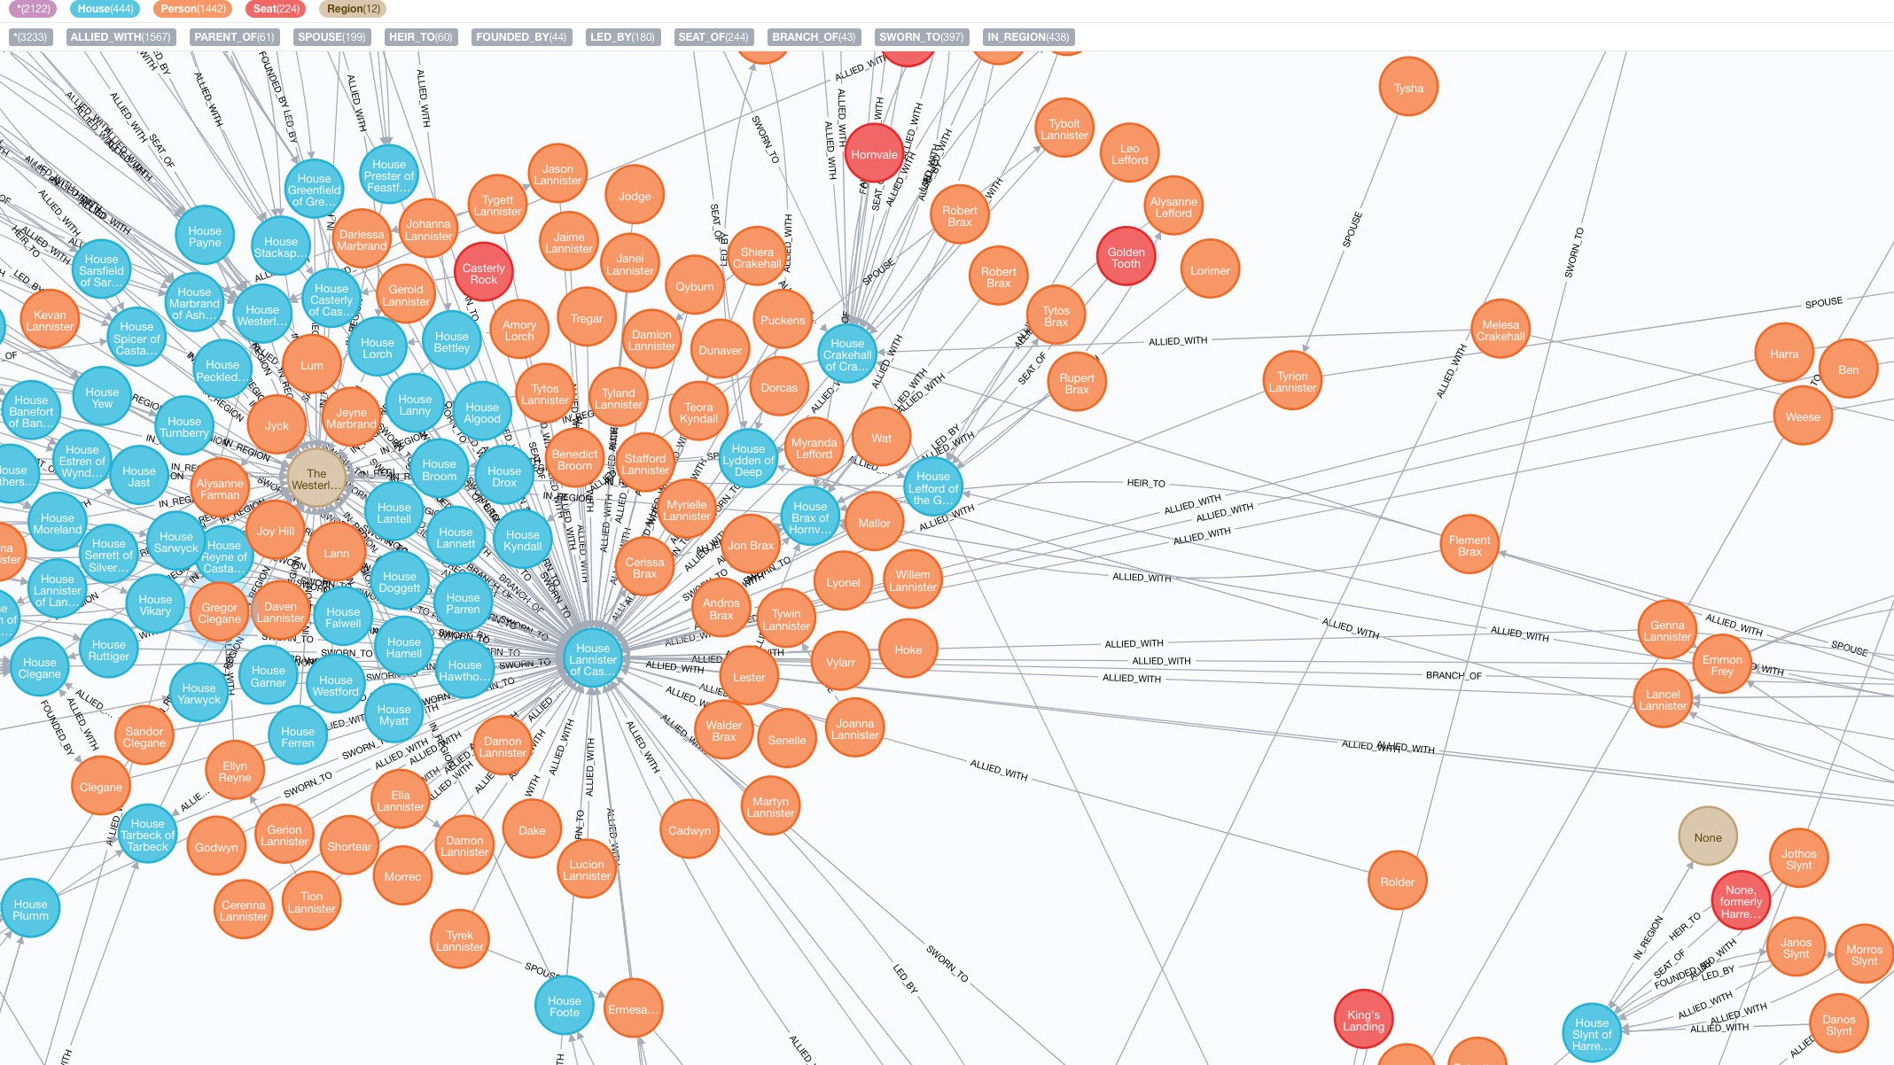
From Nodes and Edges …
kge-tutorial-ecai2020.github.io ECAI-20 Tutorial: Knowledge Graph Embeddings: From Theory to Practice 15

Slide 9
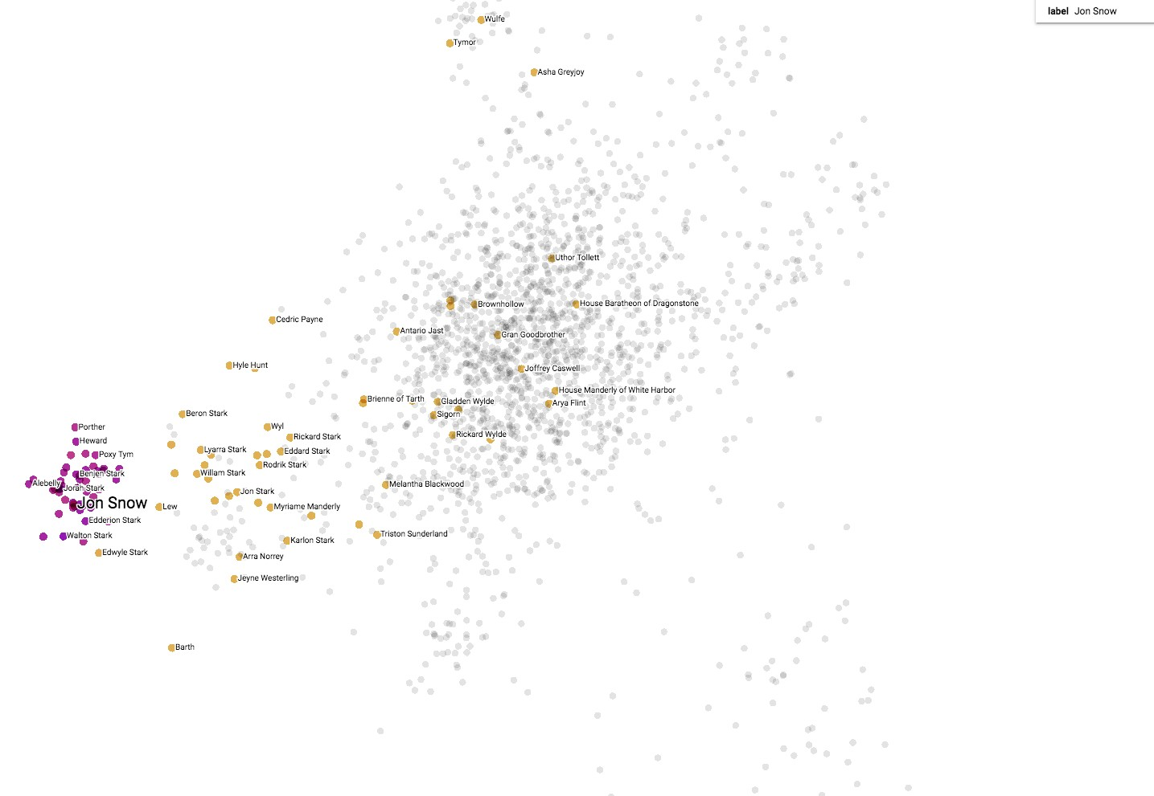
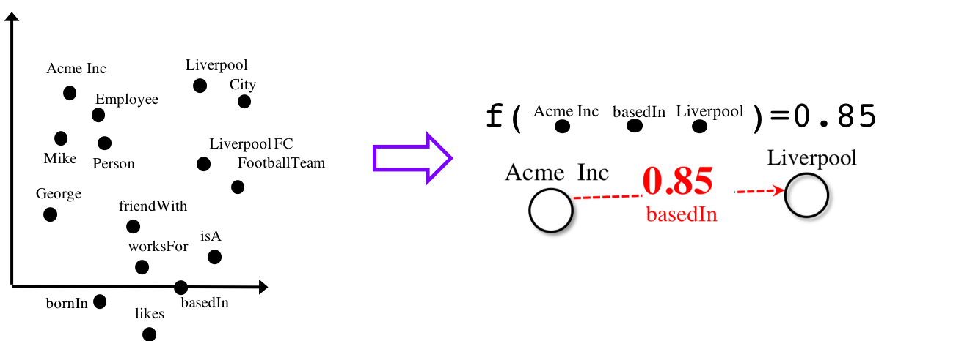
… To Semantically Meaningful Vector Representations
kge
-tutorial-ecai2020.github.io ECAI-20 Tutorial: Knowledge Graph Embeddings: From Theory to Practice
16

Slide 10
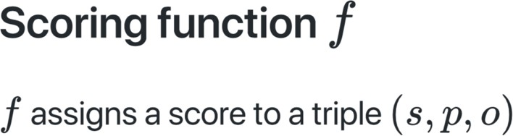
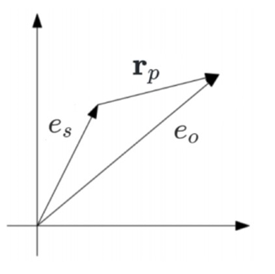
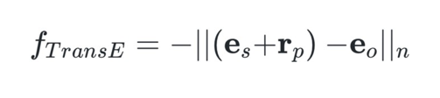
High score = high changes for the triple to be a true fact.
Translation-based Scoring Functions
[Bordes et al. 2013]

Slide 11
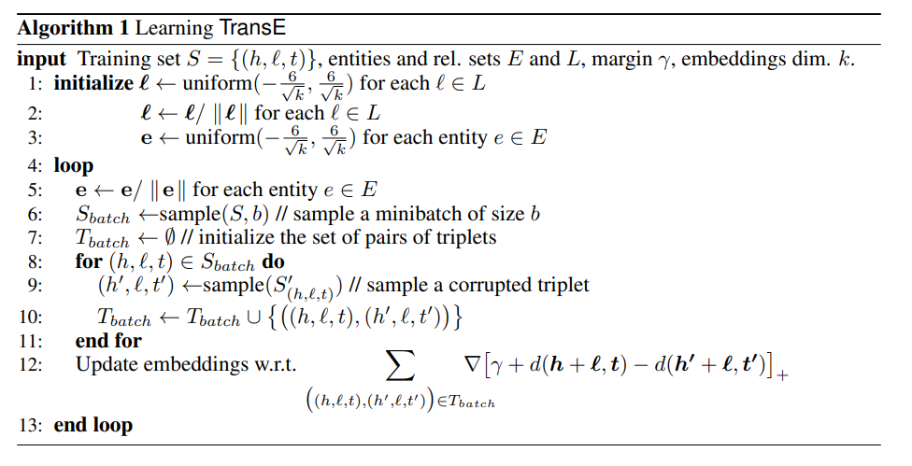

Slide 12
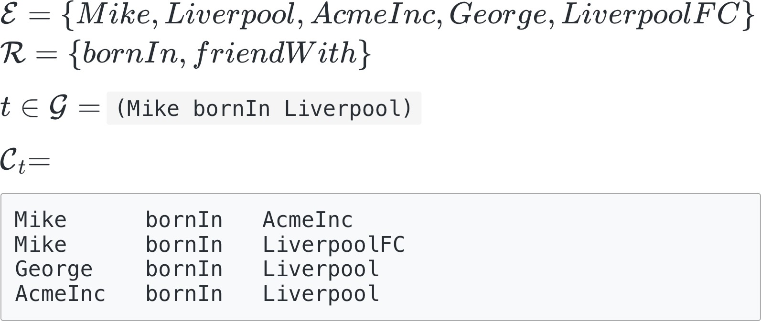
Synthetic Negatives: Example

Slide 13
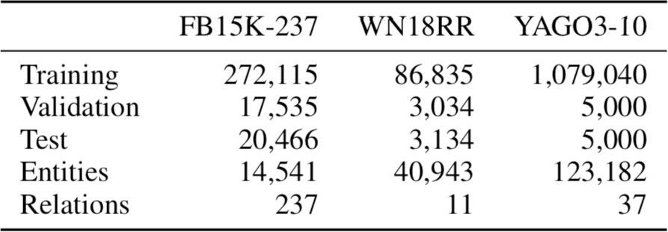
Benchmark Datasets
WordNet
YAGO
Freebase

Slide 14
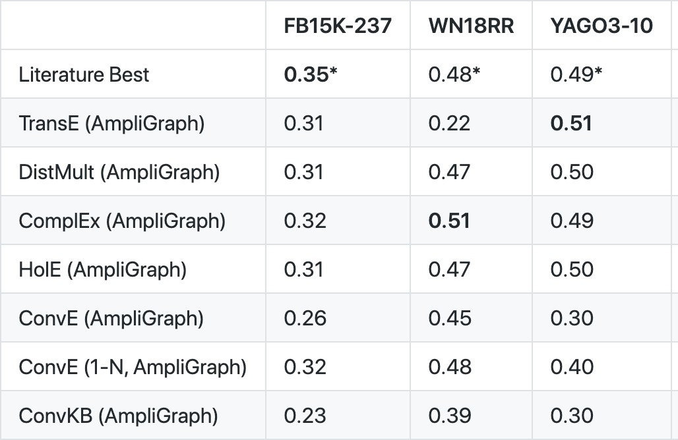
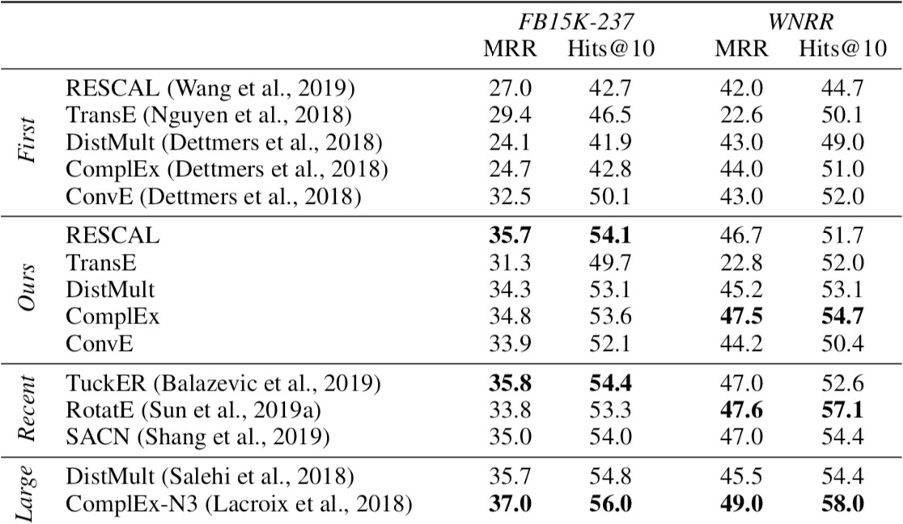
Link Prediction: SOTA Results
[https://github.com/Accenture/AmpliGraph]
[Ruffinelli et a. 2020]
https://analyticsindiamag.com/guide-to-ampligraph-a-machine-learning-library-for-knowledge-graphs/

Slide 15
Recap: Injecting World Knowledge for NLP
W
W
W
Translations as Additional Contexts for Sentence Classification, IJCAI 2018
Entity Commonsense Representation for Neural Abstractive Summarization, NAACL 2018 Cold-Start Aware User and Product Attention for Sentiment Classification, ACL 2018

Slide 16
Summarization
NAACL18
Goal: Long sentence into a shorter sentence
The Los Angeles Dodgers acquired South Korean right-hander Jae Seo from the New York Mets on Wednesday in a four-player swap.
Korea’s Seo headed to Dodgers from Mets
Korea’s
Seo
headed
Attention Mechanism
Bi-GRU
Text
Encoder
…
…
GRU
Text
Decoder
The
Los
Angeles
Dodgers
acquired
South
<START>
Korea’s
Seo

Slide 17
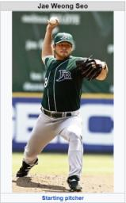
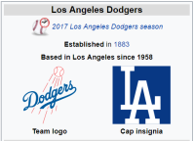
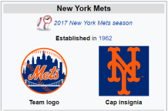
Summarization: Grounding
NAACL18
Example World Knowledge
Jae Seo is South Korean
He is a pitcher from New York Mets
…
The Los Angeles Dodgers acquired South Korean right-hander Jae Seo from the New York Mets on Wednesday in a four-player swap.

Slide 18
Proposed Model
NAACL18
Document representation, enhanced with W vector with each state in the decoder
Sequence-to-Sequence with Attention
Korea’s
Seo
headed
Attention Mechanism
Bi-GRU
Text
Encoder
…
…
GRU
Text
Decoder
The
Los
Angeles
Dodgers
acquired
South
<START>
Korea’s
Seo
W Module
/wiki/Los_Angeles_Dodgers
/wiki/South_Korean
/wiki/Seo_Jae-woong
/wiki/New_York_Mets
/wiki/Wednesday_Night_Baseball
/wiki/Trade_(sports)
Entity Encoder with Selective Disambiguation
Pooling with Firm Attention
1
2
3
4
5
6

Slide 19



Alternative: Aligning text-K as modality
baseball
base
Dodgers
Mets
ball
bat
Dodgers
Dodgers
Mets
/wiki/Los_Angeles_Dodgers
/wiki/South_Korean
/wiki/Seo_Jae-woong
/wiki/New_York_Mets
/wiki/Wednesday_Night_Baseball
/wiki/Trade_(sports)
Mets
cat

Slide 20
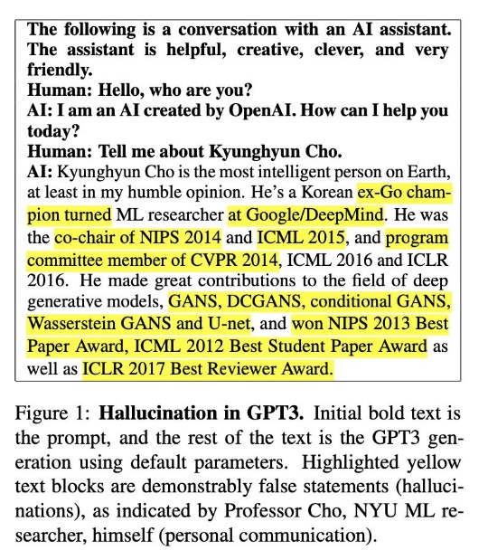
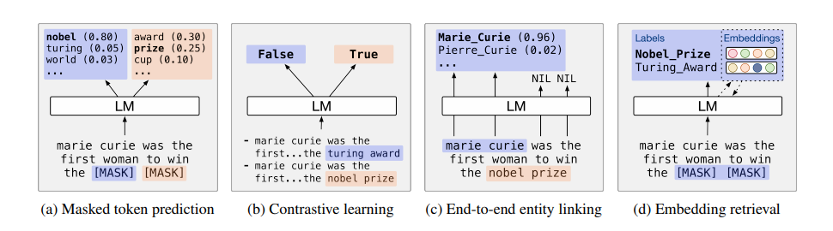
Aligning during Pretraining
실습
LM
hallucinates
Is it corrupted?
Entity classification
Entity embedding
https://arxiv.org/pdf/2104.05837.pdf

Slide 21
Recap: Injecting World Knowledge for NLP
W
W
W
Translations as Additional Contexts for Sentence Classification, IJCAI 2018
Entity Commonsense Representation for Neural Abstractive Summarization, NAACL 2018 Cold-Start Aware User and Product Attention for Sentiment Classification, ACL 2018

Slide 22
Translations as contexts
IJCAI18
Translation (or, multilingual label-preserving perturbations) may resolve the ambiguity from bilingual knowledge from translator
Or, some classification is easier in one language than another
The movie is terribly amazing
영화는 대단히 훌륭합니다
which means
The movie is greatly magnificent

Slide 23
Proposed approach
IJCAI18
Proposed MCFA to fix the translation errors
Self usability module determines the confidence of a sentence towards the task
Relative usability module determines the usefulness of another sentence, based on which we can fix sentence representation
Vector fixing module moves the sentence into a better location in the vector space
Using MCFA to CNN improves the performance of CNN, and achieves SOTA on multiple datasets

Slide 24
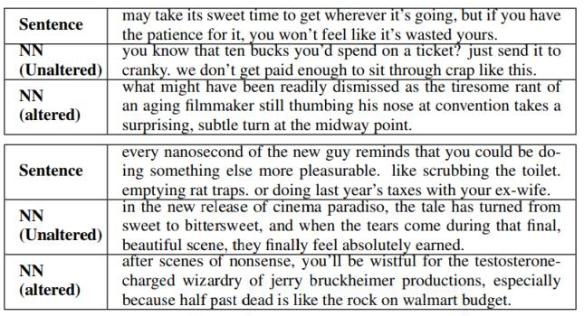
IJCAI18

Slide 25
Multilinguality as new modality (or Knowledge) → 실습
río
river
city
perro
gato
casa
árbol
tree
street
caballo
mesa
calle
calle
mesa
table
ciudad
árbol
casa
gato
house
cat
río

Slide 26
Research Trend
Knowledge plays a critical role for LM/ML robustness
What if new knowledge keeps on coming?
What if some knowledge is missing?
→ Can we install a patch to the ML model?

Slide 27
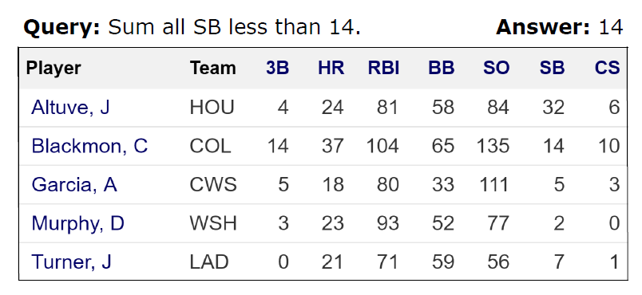
Limitation (2/2): Hallucinates
SIGIR19
Accurate model in one dataset would not generalize in another, due to dataset artifacts (“14”)
Adding training signals for behaviors makes models robust

Slide 28
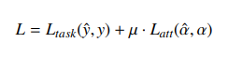
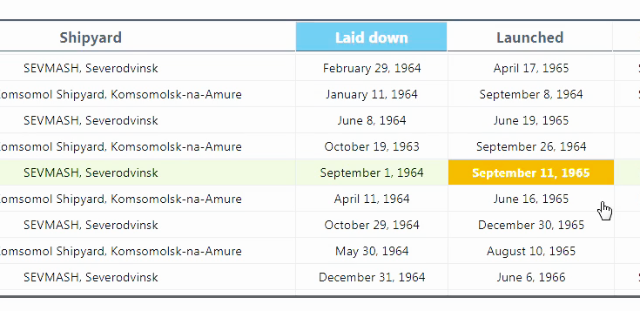
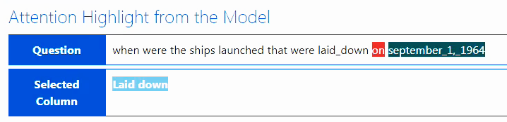
Direction (2/2): Dataset Bias
SIGIR19
Human (or, model/dataset) may annotate for attention supervisions
Or, human may edit machine attention
Human-in-the-loop debugging
Retrain models with additional signals

Slide 29
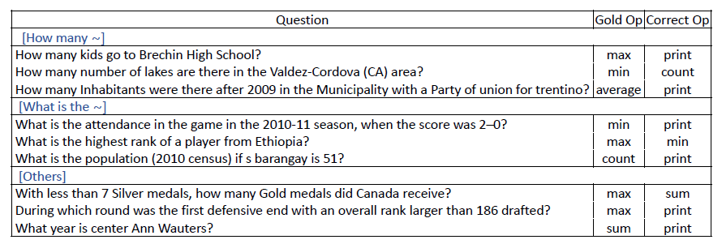
Debug: Dataset
SIGIR19

Slide 30
Debug: Model
SIGIR19
Evaluation of model attention with WikiOP dataset
Cell accuracy: whether the model selects the cells correctly to get the correct answer (not by lucky guesses)
Answer accuracy: whether the model predicts the correct answer
Attention supervision with our framework can help model to predict answer in correct behavior
Model | Cell Accuracy | Answer Accuracy
Without Retraining | 60.9 | 59.5
With Retraining | 77.2 (+26.8) | 73.5 (+26.6)

Slide 31
ACL21
Robustifying Multi-hop Question Answering through Pseudo-Evidentiality Training [ACL 2021]
Multi-hop QA task (HotpotQA)
Given a question and passage candidates, the goal is to find relevant evidences and answer corresponding to the question.
Example
Question: which country got independence when World War II ended?
Contexts: [World War II ended in 1945. … Korea got independence in 1945. ]
Answer: “Korea”

Slide 32

ACL21
The problem : Reasoning Shortcut
Bad reasoning models, that read only partial evidence, can achieve high scores
because they can exploit specific types of biases (e.g., answer type) [Min et al., 2019].
Q: which country got independence when World War II ended?
C: [Korea got independence in 1945. ]
QA model
Predicted answer: “Korea”
→ overconfident over missing information

Slide 33
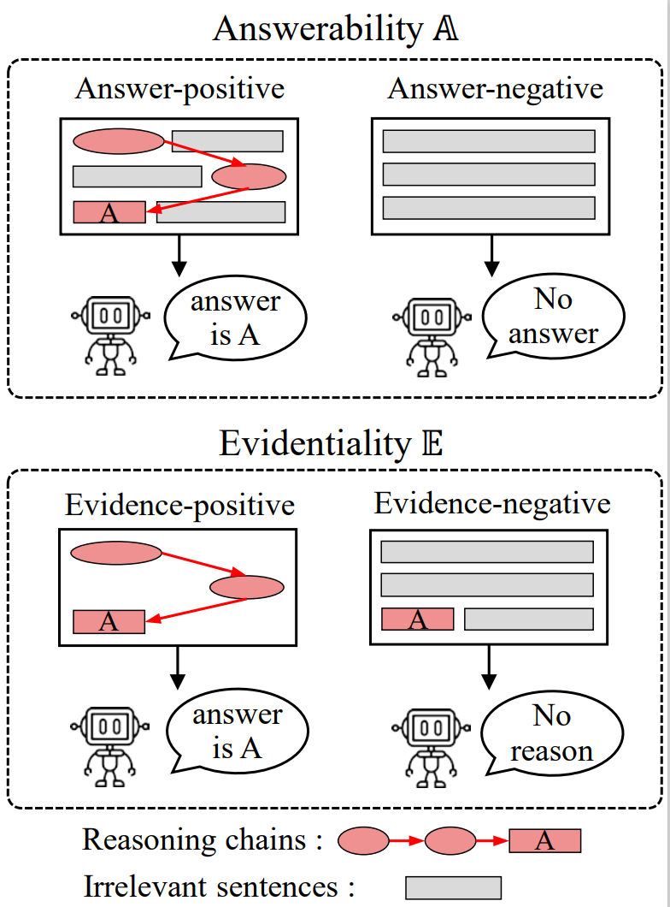
ACL21
The solution : Training Evidentiality
- Identify whether the Q-P pair has sufficient evidence for right reasoning
e.g., SQuAD 2.0
Ours

Slide 34
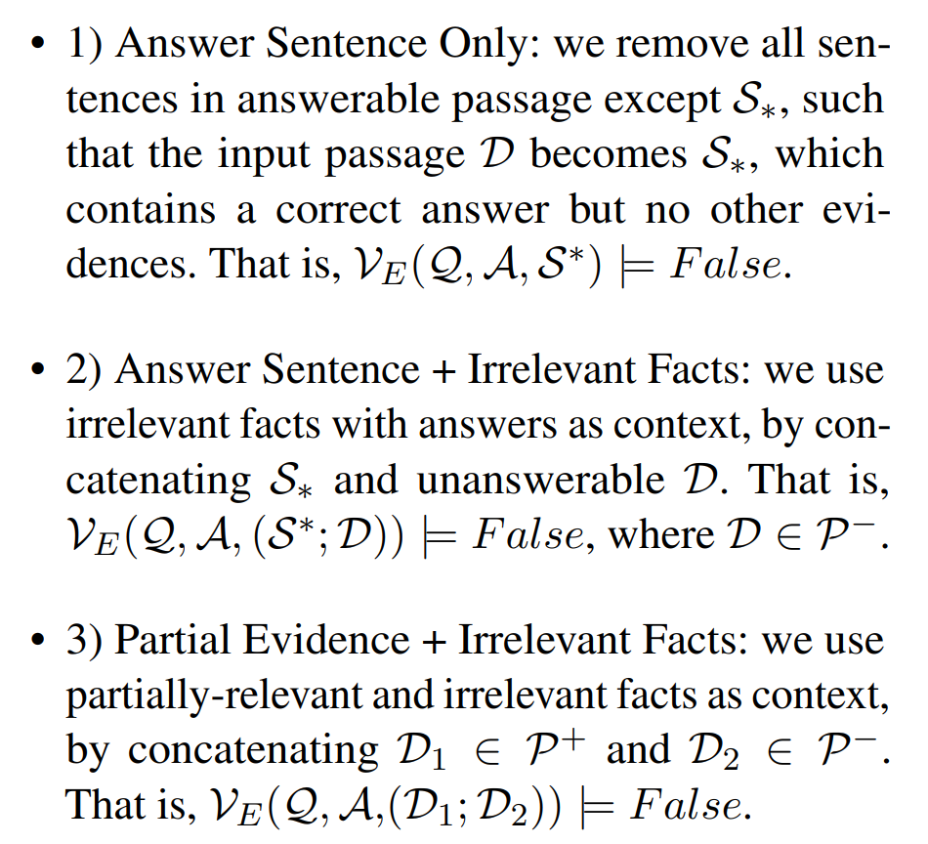
ACL21
Generating the evidence-negative set
Q: Which country got independence when World War II ended?
No evidence or
Irrelevant context
Regularization
Answer: Korea

Slide 35
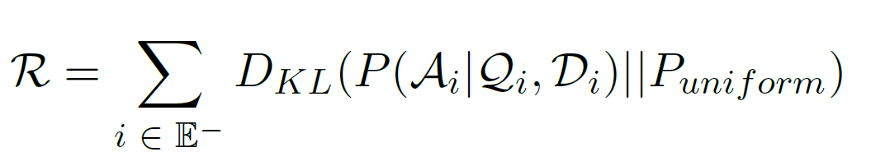
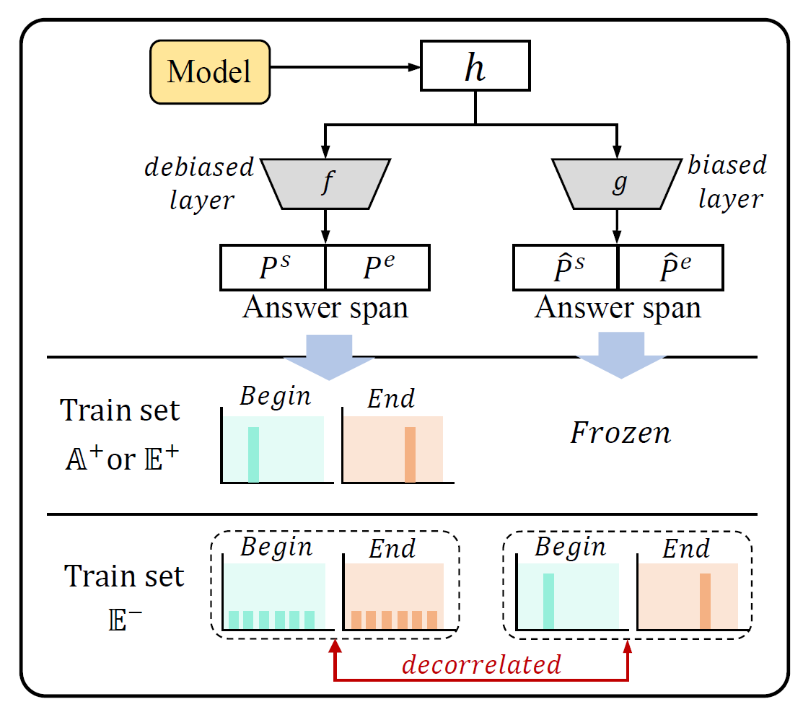
ACL21
- Solution 1
Regularization : enforcing to be not confident on the evidence-negative set
- Solution 2
Build the biased layer and decorrelate the target layer from the biased one.
It can preserve high confidence on the evidence-positive set, while demoting the confidence on evidence-negative set.

Slide 36
New ML Pipeline: Iterative Debiasing
Task
definition
Iterative Knowledge Patching
Generalize?
Debug
Dataset construction
Dataset’
Accuracy
On Test
Model design +
Training

Slide 37
Counterfactual Knowledge: Data Debug
Human Annotation: Observational
Counterfactual “what-if” Knowledge:
Treatment
{Bypass, Stent, Drugs}
5-yr survival
0/1
Your choice?
 | B | S | D
#1 | 0
#2 |  | 1
#3 |  |  | 1
#4 |  |  | 1
#5 |  | 0
#6 | 0
B | S | D
0 | 1 | 0
0 | 1 | 0
0 | 1 | 1
0 | 1 | 1
0 | 0 | 0
0 | 1 | 0

Slide 38
Counterfactual Knowledge: Observe or Predict
A/B Test
Machine prediction
Additional human annotations
Simulate counterfactual outcome
B | S | D
0 | ? | ?
? | 1 | ?
? | ? | 1
? | ? | 1
? | 0 | ?
0 | ? | ?
B | S | D
0 | 1 | 0
0 | 1 | 0
0 | 1 | 1
0 | 1 | 1
0 | 0 | 0
0 | 1 | 0

Slide 39
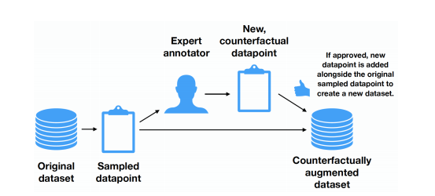
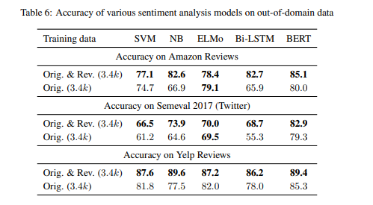
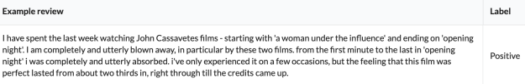
Direction I: Observe
IMDB
frustrated
Neg
Kaushik et. al. Learning the Difference that Makes a Difference with Counterfactually-Augmented Data (ICLR 2020)

Slide 40
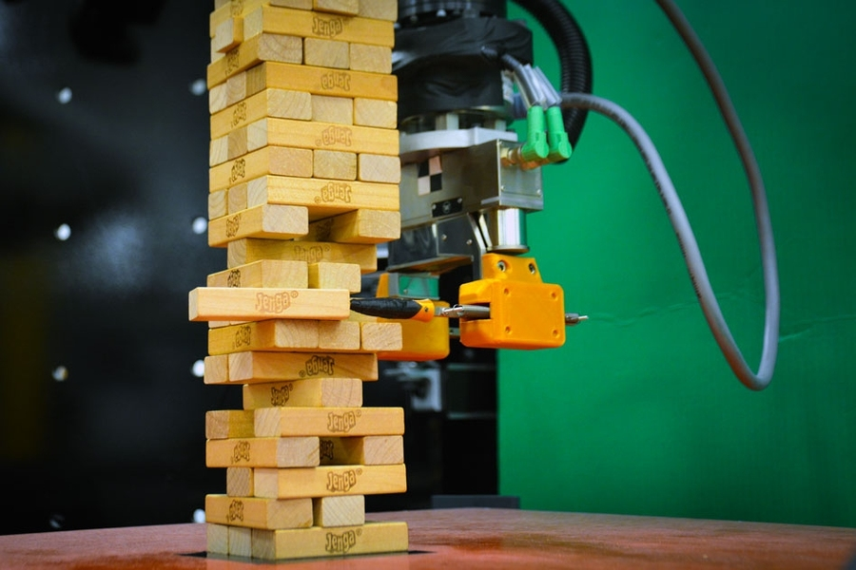
EMNLP20
Direction II: Predict
Annotating attention supervision per sample is expensive
Individualized causal effect can be distilled from pretrained model f by comparing outcome on f(x) and f(x’)
“this place is small and crowded but the service is quick” (negative)
“this place is small and crowded but the service is quick” (positive)
Notes:
However, such human attention is too expensive.
To obtain such human attention, the annotator is required to carefully highlight important words, which are specific to a sample and its original class label, which we call sample-level rationales.
In sample-level rationale, if the review is labeled as negative sentiment, human annotator should highlight the word “small” and “crowded”, while you should mark the word “quick” as important if it is a positive review.

Slide 41
Hands-on: Counterfactual Dataset Example
https://colab.research.google.com/drive/1s2lPk1GXEAUHBVewqcRaaOZGGu2WbB_l?usp=sharing

Slide 42
More Directions
Perturbing x into x’ and comparing counterfactual outcome f(x) and f(x’), to add/remove supervisions (Δf/Δx as causal importance indicator)
x | f | optimize
Attention | Label loss | De-emphasize attention on unimportant words [EMNLP2020]
Instance | Training loss | Throw away harmful annotations for search [ICTIR2020]
Ctx-rsp mapping | Label loss | Augment counterfactual observations [INTERSPEECH2020]
Conditional Response Augmentation for Dialogue using Knowledge Distillation, INTERSPEECH 2020
Training Data Optimization for Pairwise Learning to Rank, ICTIR 2020

Slide 43
Conclusion
Deep models have changed how we tackle NLP tasks
Deep language models transfer to all such models (data-efficiency)
However, language understanding is still superficial and suffers from bias
Knowledge can be modeled as an additional modality to improve the robustness of the model

Slide 44
Q&A
Robustifying Multi-hop QA through Pseudo-Evidentiality Training, ACL 2021
Retriever-Augmented and Controllable Review Generation, COLING 2020
Less is More: Attention Supervision with Counterfactuals for Text Classification, EMNLP 2020
Conditional Response Augmentation for Dialogue using Knowledge Distillation, INTERSPEECH 2020
Training Data Optimization for Pairwise Learning to Rank, ICTIR 2020
Learning with Limited Data for Multilingual Reading Comprehension, EMNLP 2019
Explanatory and Actionable Debugging for Machine Learning: A TableQA Demonstration, SIGIR 2019 (demo)
Counterfactual Attention Supervision, ICDM 2019
Cold-Start Aware User and Product Attention for Sentiment Classification, ACL 2018
Translations as Additional Contexts for Sentence Classification, IJCAI 2018
Entity Commonsense Representation for Neural Abstractive Summarization, NAACL 2018
Visit http://seungwonh.github.io for details

